Slide 1
1.7.2 Multinomial Naïve Bayes
XIAO LIYING

Slide 2

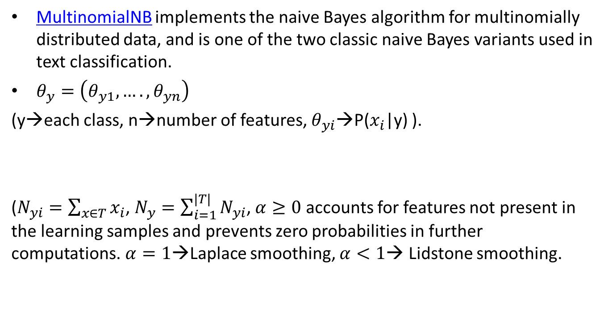
1.7.2 Multinomial Naïve Bayes
MultinomialNB implements the naive Bayes algorithm for multinomially distributed data, and is one of the two classic naive Bayes variants used in text classification.
$θ_{y}=\left(θ_{y1},….,θ_{yn}\right)$
(y→each class, n→number of features, $θ_{yi}$→P($x_{i}$|y) ).
($N_{yi}=\sum_{x∈T}{x_{i}}$, $N_{y}=\sum_{i=1}^{|T|}{N_{yi}}$, $α≥0$ accounts for features not present in the learning samples and prevents zero probabilities in further computations.$α=1$→Laplace smoothing, $α<1$→ Lidstone smoothing.

