Slide 1
1.5. Gaussian Processes
1.5.1. Examples
1.5.1.1. An introductory regression example
1.5.1.2. Fitting Noisy Data
XIAO LIYING

Slide 2
1.5. Gaussian Processes
Gaussian Processes for Machine Learning (GPML) is a generic supervised learning method primarily designed to solve regression problems.
The advantages of Gaussian Processes for Machine Learning are:
The prediction interpolates the observations (at least for regular correlation models).
The prediction is probabilistic (Gaussian) so that one can compute empirical confidence intervals and exceedance probabilities.
Versatile: different linear regression models and correlation models can be specified.

Slide 3
The disadvantages of Gaussian Processes for Machine Learning include:
It is not sparse.
It loses efficiency in high dimensional spaces – namely when the number of features exceeds a few dozens.
Classification is only a post-processing.

Slide 4
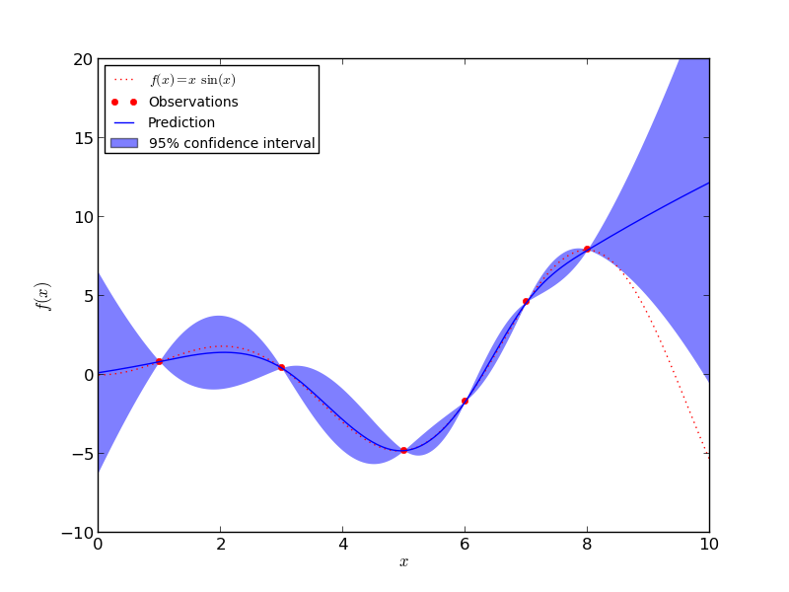
1.5.1.1 An introductory regression example
The function g(x)=xsin(x). the function is evaluated onto a design of experiments.

Slide 5
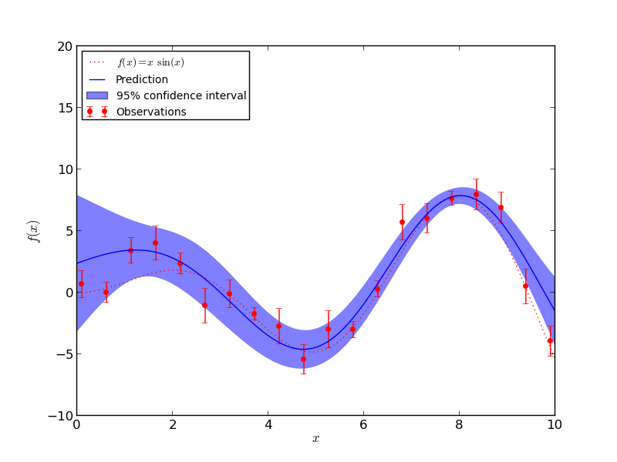

1.5.1.2 Fitting Noisy Data
When the data to be fit includes noise, the Gaussian process model can be used by specifying the variance of the noise for each point. With nugget and corrproperly set, Gaussian Processes can be used to robustly recover an underlying function from noisy data:
$nugget_{i}={\left[\frac{бi}{yi}\right]}^{2}$

