Slide 1
Mathematical formulation
XIAO LIYING

Slide 2
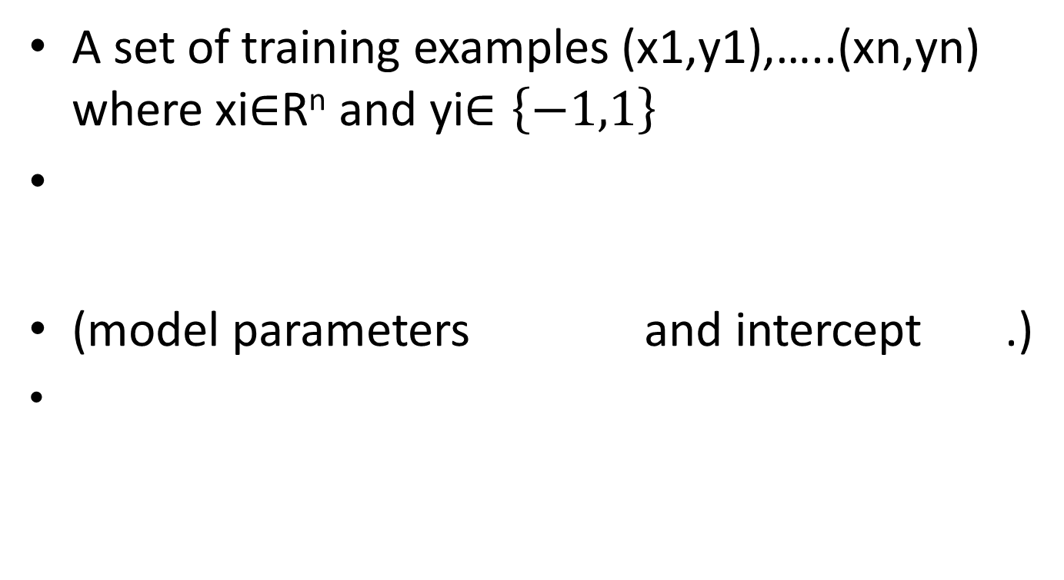
Mathematical formulation
A set of training examples (x1,y1),…..(xn,yn) where xi$∈$R^{n} and yi$∈\left\{−1,1\right\}$
(model parameters and intercept .)

Slide 3

Mathematical formulation
A common choice to find the model parameters is by minimizing the regularized training error given by
L is a loss function that measure model fit.
R is a regularization term (aka penalty) that penalizes model complexity
is a non-negative hyperparameter

Slide 4
Mathematical formulation
Different choices for L entail different classifiers such as
Hinge: (soft-margin) Support Vector Machines.
Log: Logistic Regression.
Least-Squares: Ridge Regression.
Epsilon-Insensitive: (soft-margin) Support Vector Regression.
All of the above loss functions can be regarded as an upper bound on the misclassification error (Zero-one loss) as shown in the Figure below.

Slide 5
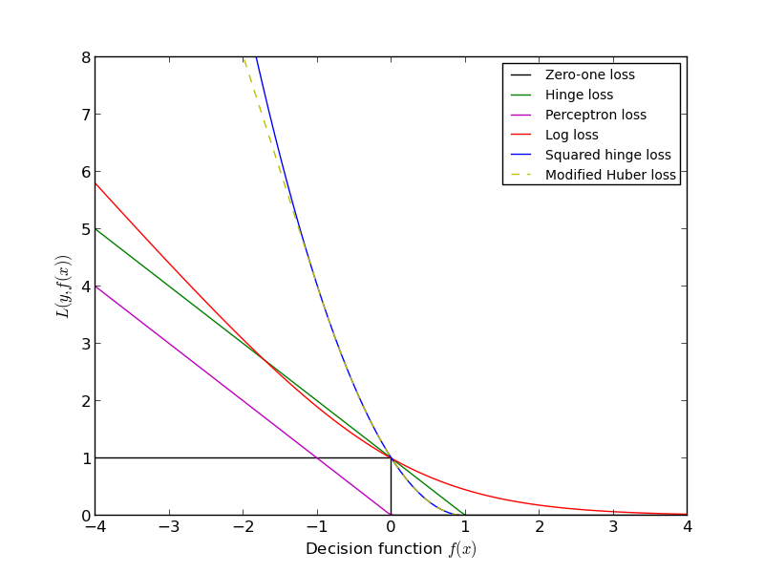
Mathematical formulation

Slide 6
Mathematical formulation
Popular choices for the regularization term R include:
L2 norm:
L1 norm: , which leads to sparse solutions.
Elastic Net: , a convex combination of L2 and L1, where is given by 1 - l1_ratio.
The Figure below shows the contours of the different regularization terms in the parameter space when

Slide 7
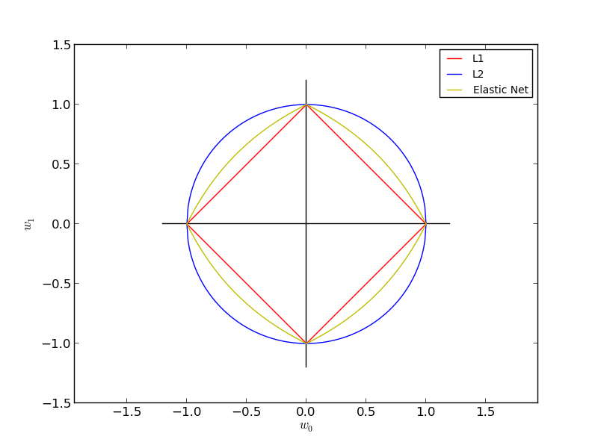
The Figure below shows the contours of the different regularization terms in the parameter space when .

Slide 8

1.3.6.1 SGD
Stochastic gradient descent is an optimization method for unconstrained optimization problems. In contrast to (batch) gradient descent, SGD approximates the true gradient of by considering a single training example at a time.
Where is the learning rate which controls the step-size in the parameter space. The intercept b is updated similarly but without regularization.

